Slide 1

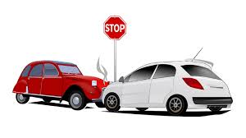

Maryland Statewide Vehicle crash

Slide 2


Contents
Little stat
What was the purpose of the research ?
Analysis of the data
What was the time of the day during which accident happened the most?
What year did the most accident happened
Type of damages
Weather condition and accident happening
Outcome Of the research ?
References

Slide 3
Little stat
NPR reports that 94 percent of deadly car crashes are caused by some type of human error. Unless and until there are fully autonomous cars that drive themselves, the mistakes that people make will continue to cause thousands of deaths in auto accidents every year.

Slide 4
Purpose of the research
Although car accident have been cause by human Error, what factors have contributed to these errors
Was it the weather
Was it the time of the day ?(daylight, and dark)
What factors leads to the numbers of car accident to increase or decrease in some years compare to other.
What type of car accident occurred the most
How ca we prevent it

Slide 5
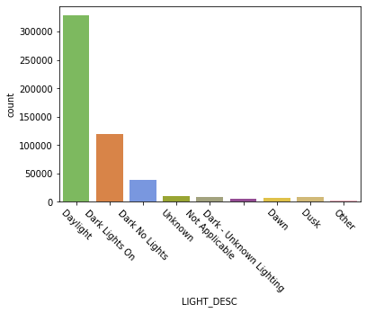
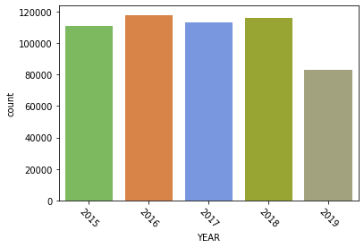
Analysis of the Data

Slide 6
References
https://www.strongtieinsurance.com/common-reasons-road-accidents/

